Slide 1



Welcome to the Sprowston Junior
SEN Information Report 2026-2027
At Sprowston Junior School we believe in achievement for all, we are committed to working together with all members of our school community. We want all adults and children to participate in learning and we celebrate all members of our community. We want to create an inclusive culture in our school and we aim to be more responsive to the diversity of children’s backgrounds, interests, experience, knowledge and skills, so that all pupils regardless of individual need make the best possible progress.
We value high quality teaching for all learners and actively monitor teaching and learning in the school. We aim to create a learning environment which is flexible enough to meet the needs of all members of our school community. We monitor progress of all learners; staff continually assess, plan, do and review ensuring that progress and learning is taking place. Our whole school system for monitoring progress includes regular pupil progress meetings.
We are proud to have a Specialist Hub of Inclusive Practice (SHIP) as part of our school.

Slide 2

Report contents
How do we identify when a child needs additional support?
What is our approach to teaching learners with SEN-D?
How do we identify the Special Educational Needs of pupils?
What are the definitions of SEND?
What is our SEN profile for 2026-2027?
Sprowston Junior SHIP
How do we support SEN-D learners?
What are our roles and responsibilities?
What opportunities do we provide for enrichment?
How do we help children move to and from our school?
Useful Links
Contacts

Slide 3

How we identify SEND
Some of our pupils may require additional support so that they can access the curriculum and make progress at their own level.
At different times in their school career, a child or young person may have a special educational need. The Code of Practice defines SEN as:
If a learner is identified as having SEN-D, we will work closely with the pupil and parents to provide provision that is ‘additional to or different from’ the normal differentiated curriculum, aiming to overcome the barrier to learning.
Children will be recorded as receiving SEN Support unless they have an EHCP
“A child or young person has SEN if they have a learning difficulty or disability which calls for special educational provision to be made for them. A child of compulsory school age or a young person has a learning difficulty or disability if they:
have a significantly greater difficulty in learning than the majority of others of the same age: or
have a disability which prevents or hinders them from making use of educational facilities of a kind generally provided for others of the same age in mainstream schools or mainstream post-16 institutions.”

Slide 4
Our Approach to Teaching Learners with SEN-D
At Sprowston Junior School we ensure that all pupils in our school are equally valued by having equal access to a broad and balanced curriculum which is differentiated to meet individual needs and abilities.
We have effective management systems and procedures for SEN-D, taking into account the current Code of Practice (2014).
We strive for effective communication between staff, children with SEN-D, parents of SEN-D children, and outside agencies.
We acknowledge and draw on parents’ knowledge and expertise in relation to their own child. Parents are invited to complete a parent passport.
We encourage children to take an increasingly active role in their termly review cycle, and all complete a pupil passport some children may have an extended passport
We work within the Sprowston Cluster to develop provision and practice. Our Cluster Handbook/ SEND policy is available on our website.
We are committed to developing the knowledge and skills of all staff to manage the challenges of the range of needs in the school, and to ensure that all support is of high quality see details of recent staff training.
We ensure that consideration of SEN-D crosses all curriculum areas and all aspects of teaching and learning.
For more details see the Policies section on our website – this will also link to other policies including accessibility, medical,safeguarding and behaviour and relationships.

Slide 5
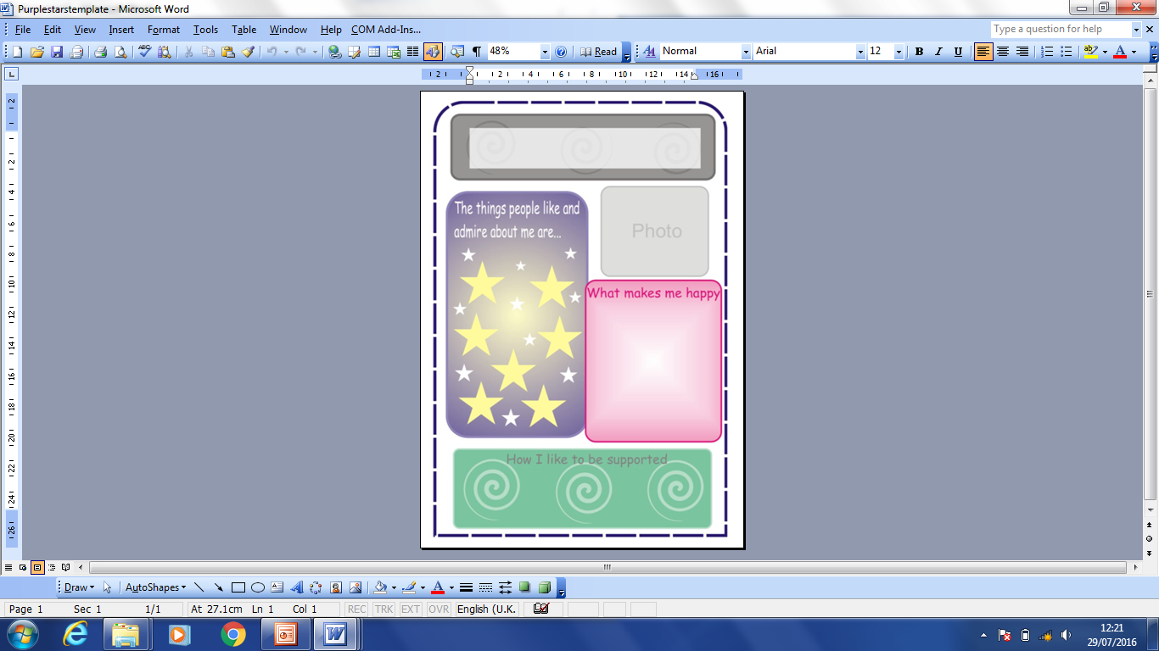
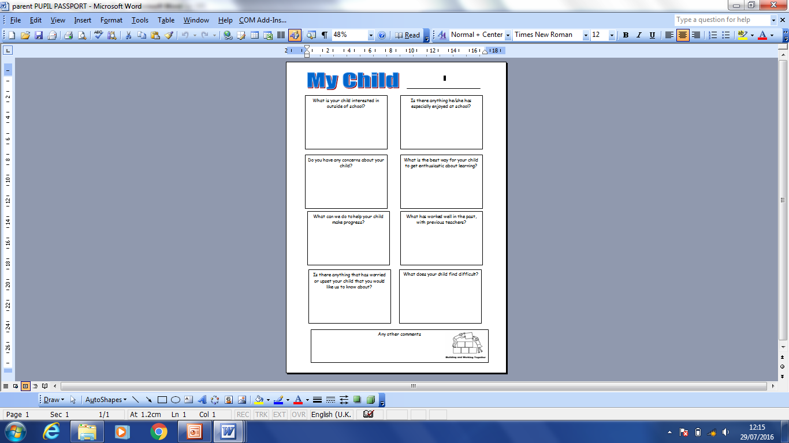
Pupil & Parent Passports

Slide 6
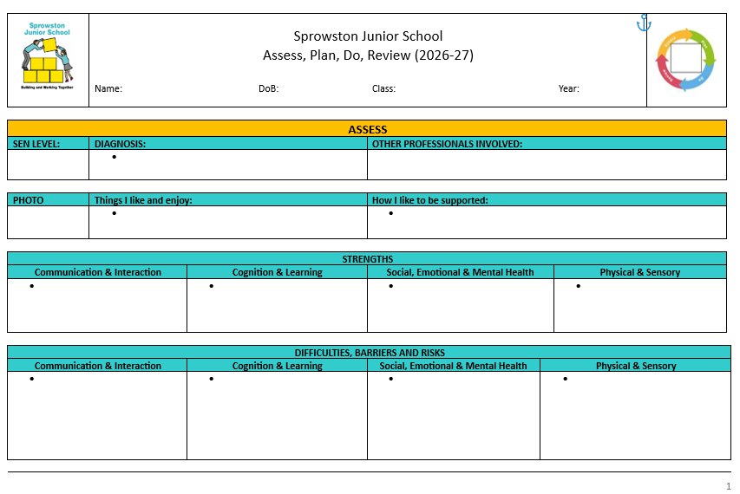
Extended Pupil Passports APDRs

Slide 7
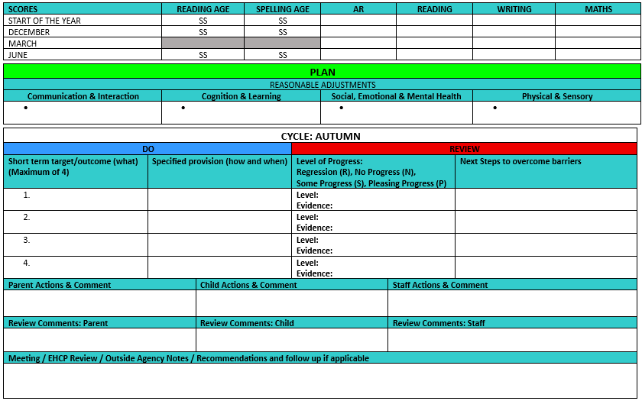
Extended Pupil Passports APDRs

Slide 8
Identifying the Special Educational Needs of pupils
Where pupils’ progress is significantly slower than that of their peers, or fails to match their previous rate of progress, despite high quality first teaching targeted at specific areas of difficulty, it may be that the child has SEN-D. Information will be gathered, including seeking the views of parents and the pupil, as well as from teachers and assessments.
There can be a many reasons for learners ‘falling behind.’ These may include absences, attending lots of different schools, difficulties with speaking English, or worries that distract them from learning. Children who experience such barriers to learning are vulnerable, but this does not mean that all vulnerable learners have SEN-D. Only those with a learning difficulty that requires special educational provision ‘additional to’ or ‘different from’ the usual differentiated curricular will be identified as having SEN-D.
Once a child is identified as having SEN-D we follow an ASSESS-PLAN-DO & REVIEW cycle. This involves regular meetings with child and parent to monitor and to assess and review progress and outcomes.

Slide 9

Definitions
Cognition and Learning Children might
Learn at a slower pace
Find the curriculum difficult
Struggle with organisation and memory
Have a specific difficulty in literacy or numeracy
Communication and Interaction Children might
Struggle to talk or say what they want to
Find it hard to understand what others are saying
Find conversations and play confusing and challenging
Have a diagnosis of ASD
Social, Emotional & Mental Health Difficulties Children might
Find relationships difficult, appear withdrawn or isolated
Behave in ways that affect their learning – eg being disruptive or challenging
Do things that impact on their health and wellbeing
Have underlying mental health difficulties such as anxiety, depression, self-harming, substance misuse, eating disorders or physical symptoms that are medically unexplained.
Have disorders eg ADD, ADHD, Attachment Disorder that could negatively impact on their SEMH.
Sensory and / or Physical Children might have a disability such as
A visual or hearing impairment, a physical difficulty
Some pupils may have SEN that covers more than one of these areas

Slide 10
Our SEN profile for 2026-2027
We have 25% (Nationally 19.6% Jan 2026) of children identified as having SEN-D. This percentage is made up of the following groups:
24% (6%of school) are identified as having SEN-D linked to Cognition and Learning (including maths, reading, writing and spelling etc.)
44% (11%of school) are identified as having SEN-D linked to Communication and Interaction (including speech and language difficulties and problems with social interaction)
24% (6%of school) are identified as having SEN-D linked to Social, Emotional and Mental Health (including ADHD, ADD, Attachment Disorder, Eating Disorder, anxiety, depression and behavioural difficulties)
6% (1%of school) are identified as having SEN-D are linked to Physical and Sensory (including disabilities such as those affecting mobility, sight and hearing)
Many of our pupils have needs in more than one group, percentages show the primary need.
This data may change over the year but was accurate in October 2026
8% - (14% including SHIP) (Nationally 5.3%)of our school population have an Educational and Health Care Plan. 40% (58% including SHIP) of total children identified as having SEN-D.)
11% - (10% including SHIP) (Nationally 14.2%) of our school population are classified as receiving SEN Support
We receive funding to support the needs of learners with SEN-D. The amount (SEN Notional) we are due to receive in 2026-2027 is £66,006.

Slide 11
SEN Profile 2026-2027

Slide 12
SEN Profile 2026-2027
For national data visit https://www.gov.uk/government/collections/statistics-special-educational-needs-sen

Slide 13
Sprowston Junior SHIP
Sprowston Junior has a SHIP (Specialist Hub of Inclusive Practice)
A SHIP is an inclusive provision within a mainstream school that enables children with a range of special educational needs and/or disabilities to have access to individualised and small groups support whilst also benefitting from inclusive practice within the mainstream setting.
The SHIP offers children with a range of co-occurring needs such as neurodiversity, social emotional and mental health and learning difficulties a place to learn and develop where they are not able to access their all learning in the mainstream classroom.
Admissions to The SHIP are through a county panel.
Norfolk Schools SHIP Profile
Sprowston SHIP on SJS website

Slide 14
How we support SEN-D learners
Quality first teaching by class teacher
Targeted interventions
Specified Individual support
Specialist sessions run by outside agencies
Cognition and Learning Support
Communication and Interaction Support
Social Emotional and Mental Health Support
Sensory and Physical Support
Assess – Plan – Do – Review
EHCPs

Slide 15
Quality first teaching by class teacher
For your child this would mean:
That the teacher has the highest possible expectations for your child and all pupils in their class
That all teaching is built on what your child already knows, can do and can understand, your child will complete a pupil passport to show how they best learn.
Different ways of teaching are in place so that your child is fully involved in learning in class, through challenge and reasonable adaptions
Specific strategies (which may be suggested by the SENCo or outside agencies) are in place to support children to learn
The environment so that it is calm and well resourced – children are taught how to use scaffolds and support independently.
That staff will let you know what your child is learning and use the Home-School Journal to make comments about successes and concerns.
Your child’s progress is constantly assessed, monitored and reviewed and any gap or gaps in their understanding/learning will be identified and addressed through targets and interventions.
The policies section of our website provides further details.

Slide 16

Targeted Interventions
These may be run in the classroom or in sessions outside of whole class learning
They may be delivered by a teacher or teaching assistant
These are usually group sessions with specific targets to help them to make progress, targets are used in both group and class work
Targets may form part of your child’s pupil passport
Interventions will be assessed and monitored by the school leadership team
Parents are informed when their child is in intervention groups and targets and progress are shared
Parents invited to attend sessions to share the aims and work of these groups and then support with follow up at home as required
Pupils evaluate their work in groups after each session and as part of end of unit reviews

Slide 17

Individual Support
Some pupils will follow 1-1 work; such as if the learner has an Education Health and Care Plan or if they have been assessed by outside agencies
Children with Social and Emotional and Mental Health needs are support by external programmes alongside those run by the school’s team of TAs
Individuals have access to aids and materials to support their learning eg wedge cushions, ear defenders, ATT laptops etc
There will be regular formal reviews and informal meetings to discuss provision and progress between staff, parents and pupils.
Chidren in all classes have access to Zones of Regulation resources and access to sensory regulation equipment.

Slide 18
Sessions run by outside agencies
This may be from services such as:
  Access Through Technology
  CAMHS Child & Adolescent Mental Health Services
  CEPP – the Child and Educational Psychology Service
  Dyslexia Outreach Support
  Educational Psychology & Specialist Support EPSS
  Leeway / NIDAS
  Nelsons Journey
  Norfolk & Waveney Speech and Language Therapy Service
  Norfolk Early Help
  Norfolk Virtual School
  Norwich Mental Health Support Team MHST
  Occupational Therapists
  Paediatricians
  Physiotherapists
  School Nursing Team (Just One Number) 0300 300 0123
  SEND & Inclusion Line 0333 313 7165
  Virtual School Sensory Support
  Young Carers / Carers Matters

Slide 19
ASSESS, PLAN, DO and REVIEW
When providing support that is additional to or different from we engage in a four stage process: ASSESS, PLAN, DO and REVIEW.
Assess – this involves taking into consideration all the information from discussions from parents or carers, the child, the teacher, support staff and a variety of assessments. Results are used to inform pupil progress meetings, reviews, reports and one page profiles. Data is used to measure and assess progress of pupils with SEND and shared and discussed with governors.
Plan – this stage identifies the barriers to learning, intended outcomes and details what additional support will be provided to help overcome the barriers. Decisions will be recorded and will form part of the parent/ teacher consultations.
Do – providing the support as set out in the plan.
Review – measuring the impact and deciding whether changes to the support will be made. We will evaluate the effectiveness of any additional support. This will be ongoing
Specific details of each level of support are given in our Provision Map - Cognition & Learning, Communication & Interaction, Social Emotional & Mental Health Difficulties and Physical & Sensory
A list of our Assessment tools is given here.
Continued

Slide 20
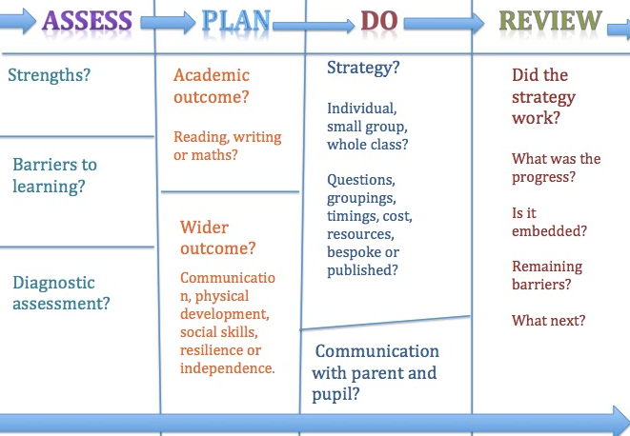
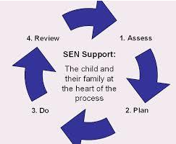

Slide 21

Cognition & Learning
Area of Need | Class | Group | 1-1
Cognition and Learning | Accelerated Reader Adapted curriculum, delivery, groups, planning and work. Assessment CLIPs Displays & Working Wall Help Mats Labelled Resources Maths resource Boxes - Modelling Next step marking Online resources –MyMaths,, TT Rockstars, Parent workshops Personalised Learning. Picture dictionary Pre and post teaching Questioning Reading/ Spelling/ tests Seating Plans Sonar tracking Steps to Success Criteria Visual aids & resources Visual timetable Vocabulary displayed Widgit Wordbanks Writing frames | Booster groups Colourful semantics ICT Numbots G&T projects Guided Groups – Reading, Writing and Maths. Homework groups In class TA Librarians Memory Groups Multi-sensory Numicon Paired work/peer mentoring Pre and post teaching Ruth Miskin RWI Ruth Miskin Fresh Start Widgit writing frames | 1-1 programmes 1-1 teaching – phonics, reading, maths, writing ACE Spelling dictionary Additional test time. ATT ICT Catch up maths and literacy Coloured overlays, reading rulers and exercise books Differentiated homework Dyslexia Outreach Norfolk Assessment Pathways Pre-teaching & Over Learning Precision Teaching SATs arrangements Scribes Spelling keyrings SRB attendance

Slide 22
Communication & Interaction
Communication and Interaction | CLASS Adaptions -delivery -pace -outcome -questioning -grouping -homework Buddies Y3/Y6 Buddy Bus stop playtime Displays – visual – symbols (+EAL) Labelled resources with picture and name Next step marking Picture Dictionary Processing Time Routines School Council meetings Seating plans Simplified language Social stories Use of TA Visual timetable Visualiser Widgit symbols Writing frames | GROUP Bi-lingual labels Class Chrome book time. Clicker In class TA support Memory work Pre-teaching Quiet space for Sp&L Reading Partners Small group EAL sessions Social Stories Speech and Language Group Talkabout groups Widgit | 1-1 meetings with new parents Transition - Y-Y KS-KS Additional test time ASD support ATT Comic Strip Conversations Communication boards Clicker 5 Point Scale Google translate Interpreters for parents meetings Lego therapy Norfolk Assessment Pathways TAs lunchtime support Talking tins Social stories SRB input Speech and Language Therapist Support Taskboards Translated reports / letters Visual timetable/organiser Widgit

Slide 23
Social Emotional & Mental Health
Social, Emotional and Mental Health Difficulties | CLASS Anti-bullying activities Attendance stickers/ certificates Buddies Y3/Y6 Celebration assemblies Class Rules Family Lunch & Family Week Feel Good Friday Home-School Journal House Points Meet & greet Mental Health Champions Mindfulness Norfolk Steps–Step On Parent Questionnaires Pastoral Rooms Playground Buddy Bus stop Pupil Questionnaires Quiet zones Rewards & Sanctions School Behaviour Policy School Council Seating plans Social Stories Transition activities Y2&Y6 Use of TA Whole school, consistent approach STEP ON Zones of Regulation | GROUP Breaktime play groups Circle of Friends Cookery – self esteem groups Cycling proficiency ELSA Emotions journals 5 Point Scale Gardening groups In class TA support Librarians Lunch Games Club. Mindfulness Group Pastoral Rooms Pastoral Room lunchtime Playleaders Sensory Circuits Social Stories Zones of Regulation | 1-1 Additional support for Transition Y-Y KS-KS Behaviour Logs / Support Plans Blob trees Boxall assessments Comic Strip conversations Circle of Friends Early Help Support Early arrivals ELSA 5 Point Scale Family Support Plans (FSPs EHAPs) Just One Number (Nursing) Lanyards Lego therapy Mental Health Support Team Norfolk Steps Training Step Up Nurture Talk 1-1 Playleaders lunchtime Reward charts Risk assessments / plans Sensory Circuits Sensory room / equipment SRB referral Social Stories Work with Social Care Work with external agencies dependent on need Zones of Regulation

Slide 24
Sensory & Physical
Area of Need | Class | Group | 1-1
Sensory and Physical | Bean bag area Coloured whiteboard Clutter free environment Displays – readable font Flexible teaching arrangements Hessian display boards Large Print Left handed equipment. Left handed seating Matt laminates for display Resources in class Seating plans – for sight, hearing and mobility Sensory areas in class Sensory boards in classes Sensory boxes in class Sensory room Teacher aware (positioning) Timers on boards Water | 2 Type Adapted Games at UEA Brain Gym Breaktime play – co-ordination group Floor desks Handwriting groups In class TA support Modified Games Day OT intervention groups Overlays Pre warning social stories for loud noise – eg fire alarm Sensory Circuits Sports Teams | Access through Technology Care plans Chair bands Coloured whiteboards, overlays, paper & books Ear defenders Enlarged work Equipment – scissors, slopes, pencils, cushions, blinds, chairs, footstools, blankets, overlays Exercises Fidgets Magnifiers Medical support Movement Breaks Nursing support Pencil Grip Physio / OT and Sensory support advice Rocker Chair Screens for workstation Sensory Circuits Standing desk 1-1 support in PE Trampoline Use of disabled toilet Writing Slope VSSS 1-1 support

Slide 25
Assessment used at
Sprowston Junior
Accelerated Reader – Reading Comprehension
Boxall Profile - SEMH
British Picture Vocabulary Scale Understanding
Earwig (SHIP)
GL Emotional Literacy –SEMH
PhAB – Phonological Assessment –Battery - Phonics
Ravens Coloured Matrices – Logic and Perception
Salford Reading – Decoding Skills
Sandwell Maths – Number Knowledge
SWRT Single Word Level Spelling Test - Spelling
Testbase maths / reading – Maths, Comprehension & SPAG
Tomal Memory Test – Memory
Wellcomm - language

Slide 26
EHCPs
While the majority of learners with SEN-D will have their needs met in this way, some may require an Education, Health and Care needs assessment to determine whether it is necessary for the Local Authority to make provision with an Education, Health and Care Plan (EHCP).
Where a child has an EHCP, there will be an annual review held in addition to the termly review meetings, taking into account the views of the child, their parent or carer, and all other professionals involved with the child.
These pupils may receive additional funding to support their needs and school may buy in a range of services.
Information about Norfolk EHCPs can be found here

Slide 27
Roles and Responsibilities
Class teacher
SHIP Lead teacher
Teaching Assistants
Curriculum Co-ordinators
SENCo
Headteacher
SEN-D Governor
Parents & Carers
Pupils

Slide 28

The Class teacher
Responsible for:
Developing positive realtionships
Checking on the progress of your child and identifying, planning any additional help your child may need (this could be things like targeted work, interventions, additional support); adapting the curriculum to meet the needs of pupils with SEN-D
Using ongoing assessments to write and reviewing Pupil Progress targets with parents each term and planning for the next term.
Planning and assessing the impact of interventions following county guidance of Norfolk Inclusive Practice Framework
Follow the guidelines in the SEN Policy and School Information Report
Working with parents, other staff, SENCo and outside agencies to support your child’s individual needs
Attending reviews and meetings as requested and discussing pupils progress in termly Pupil Progress Meetings
Ensuring that the school’s SEN-D, Anti Bullying, Accessibility, Behaviour, Safeguarding, Medical Needs, LAC and Single Equality Policies are followed in their classroom and for all the pupils they teach with any SEN-D.

Slide 29
The SHIP Lead teacher
Responsible for:
Developing positive relationships
Creating a flexible and responsive curriculum which is ambitious and aspirational and caters for individual needs
Using a variety of approaches to ongoing assessments to create targets and a personalised plan
Planning and delivering a range of specialist teaching approaches to meet the diverse needs of pupils
Provide a nurturing, therapeutic approach to behaviour
Working with parents, other staff, SENCo and outside agencies to support your child’s individual needs
Attending reviews and meetings as requested and discussing pupils progress in termly Pupil Progress Meetings
Following the guidelines in the SEN Policy and School Information Report
Sharing inclusive practice throughout the school
Ensuring that the school’s SEN-D, Anti Bullying, Accessibility, Behaviour, Safeguarding, Medical Needs, LAC and Single Equality Policies are followed in their classroom and for all the pupils they teach.
Undertaking regular professional development

Slide 30
Teaching Assistants
Teaching Assistants work with the class teacher to identify areas of support for students with SEN-D. They attend all in school training opportunities related to SEN-D. They plan with the classteacher
Their main priorities are to:
Ensure positive relationships
Support students to access the curriculum, encouraging pupils to think and act for themselves
Keep students focused on learning activities during lessons, check their processing and understanding and support them to develop ownership of tasks
Empower students to develop effective strategies that enable them to become independent learners.
Support the implementation of differentiation and specialist support strategies in the classroom.
Support students to use and then develop independence with resources such as ATT laptops, coloured overlays etc
Observe and record achievements and concerns
Attend reviews and meetings as requested
Deliver small group interventions and extend this work into class

Slide 31
Curriculum Leads
Co-ordinators are responsible for overseeing the provision of SEN in their subjects.
Their main priorities are to:
Support students to access the curriculum of their subject
Ensure resources are available to enable pupils with learning needs in the 4 areas of SEND.
Empower students to develop effective strategies that enable them to become independent learners within their subject through targeted resources.
Support the implementation of adaptive teaching methods and specialist support strategies in their subject.
Analyse provision for SEND pupils during learning walks, book scrutinies and deep dives and feedback to all staff.
Share appropriate training with other staff.
Each curriculum lead has produced a document showing how SEND pupils are supported in their subject.

Slide 32
The SENCo
Responsible for:
Ensuring that all members of staff working with your child are aware of your child’s individual needs and/or conditions and what specific adjustments need to be made to enable them to be included and make progress.
Advising staff on the development of a graduated approach using the Assess Plan Do and Review model see Norfolk Inclusive Practice Framework
Coordinating all the support for children with special educational needs or disabilities (SEN-D)
Ensuring that families are - involved in supporting your child’s learning
  - kept informed about the support your child is getting
  - involved in reviewing how they are doing.
Liaising with all the other people who may be coming into to school to help support your child’s learning; liaising with other schools about transition to and from the school.
Providing specialist support and training for teachers and support staff so that they can help children with SEN-D in the school to achieve the best progress possible.
Developing and reviewing the school’s SEN-D policy in line with Cluster Policy
Writing a termly SEN-D report for governors
Updating the school’s SEN-D records, ensuring that all the SEN-D needs of pupils in this school are known and making sure that records of you child’s progress and needs are kept.
Managing SEN budget and buying resources to meet individual needs

Slide 33
The Headteacher
Responsible for:
The day to day management of all aspects of the school, this includes the support for children with SEN-D.
The Headteacher will give responsibility to the SENCo and class teachers, but is still responsible for ensuring that your child’s needs are met.
The Headteacher must make sure that the Governing Body is kept up to date about issues relating to SEN-D.
Appointing a designated teacher for looked after and previously looked after children who will then work with the SENCo and staff to promote educational achievement of LAC pupils with SEND.

Slide 34
The SEN-D Governor
Responsible for:
Making sure that the necessary support is given for any child who attends the school, who has SEN-D.
Meeting regularly with the SENCo to evaluate the effectiveness of the School’s work with SEN-D pupils and their families.
Looking at school data to measure and assess the progress of pupils with SEND
Raise awareness of SEND at governors meetings
Review Policy and SIR

Slide 35
Parents and Carers
Responsible for:
Communicating with staff either in person or via The Home School Journal
Attending Parents Evenings and Reviews
Supporting Home Learning
Meeting with external agency staff
Sharing relevant information from outside agencies with staff

Slide 36
Pupils
Responsible for:
Completing Pupil Passport annually
Discussing progress and reviewing Pupil Passport targets termly
Completing any interventions
Participating in School Council

Slide 37

Recent Training 1
To Support Cognition and Learning
Accelerated Reader
Adaptive teaching
Clicker 8
Colourful Semantics
Co-operative Learning Interactive Patterns (CLIPs)
Dyslexia Level 2 support for Literacy
Early Years Writing
Earwig
Engagement Model
Food Hygiene
Metacognition and AI
Precision Teaching
Reading Plus
Ready Steady Read
Questioning
Read Write Inc (Phonics)
Spelling Apps & Strategies
Using AI in Schools
Walk-Thrus
Working Memory Training
CONTINUED

Slide 38
Recent Training 2
To Support Communication and Interaction
Access Through Technology laptop training
Autism Champions
Blanks level training
Building blocks -
Co-operative Learning Interactive Patterns (CLIPs)
Good Autism Practice
Speech and Language in the Classroom
Supporting EAL in Literacy
Supporting Learners with ASC
Understanding Autism
Understanding Speech and Language difficulties
Widgit training
CONTINUED

Slide 39
Recent Training 3
To Support Social and Emotional and Mental Health
ADHD & Neurodiversity
Attachment Theory
Behaviours for Learning
Certificate Course in the Theory and Practice of Nurture Groups
Dealing with High Level Disruption in Mainstream
Declarative Language
Domestic Violence Champions X2
Early Help
Emotion Coaching
ELSA Emotional Literacy x4
Kindness & Nurture Based Behaviour Management
Language for Behaviour and Emotion
Lego Therapy
Mental Health Champions x 3
Mindfulness in the Classroom
Norfolk Steps – Step Up and Step On
Nurtured Heart
Nurture Talk
Step On & Step Up
Steps Lead Professional
Support for bereaved children
Therapeutic Story Writing
Trauma Informed Practices
Working on Worries
Zones of Regulation
CONTINUED

Slide 40
Recent Training 4
To Support Physical and Sensory
Access Through Technology laptop training
Allergy / Epipen
Asthma
BSL Level 1
Diabetes
Epilepsy
First Aid
Oral Health
Sensory Attachment Training
Sensory Circuits training
Sensory Diet
Sensory Processing Training
Understanding ADHD
Visual Stress
Our SENCO attends regular training,
Norfolk SEND Forums
Sprowston Cluster SENCo Network
SHIP staff access Norfolk’s SRB training
TAs attend the Virtual Schools TA Network

Slide 41
Opportunities for Enrichment
At Sprowston Junior School we believe all learners are entitled to the same access to extra-curricular activities, and are committed to making reasonable adjustments to ensure participation for all.
For further information see our Equality and Accessibilty Policies on our website.
Club details are available from the school office or on the school website.
A list of clubs and activities available in the Broadland area can be found here
Wrap Around Care – Sprowston Clubhouse is based at SJS operating for children from both Sprowston Infant School and Sprowston Junior School.
Sprowston Clubhouse

Slide 42

Preparing for Next Steps
Transition is a part of life for all learners, whether that involves moving to a new class or moving to a new school. We recognise that transition is an important time for all children, but especially so for a child with SEN-D Consequently, we work closely with parents, children and staff of our Infant and High Schools to ensure these transitions run as smoothly as possible.
Planning for transitions will take place in the Summer Term; arrangements for transition to our school and from Sprowston Junior School to Secondary School for pupils with SEN-D will be planned according to individual need, after consultation with parents and their schools. Our cluster high school is Sprowston Community Academy, details of their local offer can be accessed here. Via https://sprowstoncommunityacademy.co.uk/learning/send
During Year 2 and Year 6, information – previously agreed with parents – will be shared with the SENCo at their previous or next school. This information will outline needs and support that has proven effective. Where possible, children will visit their new school on several occasions and, in some cases, staff from the old/new school will accompany the child on visits into our school or to their next school.
Children new to the school are given a welcome pack including information about their new class. They are also allocated a school buddy.
Some children moving to a new school year are also given an information sheet about their new class or new school as needed.

Slide 43

Useful Links
The Norfolk Local Offer Web site
https://www.norfolk.gov.uk/children-and-families/send-local-offer contains full information of the services available to children, young people and their families.
Local Offer for Children & Young People
https://www.norfolk.gov.uk/children-and-families/send-local-offer/local-offer-for-children-and-young-people
Regular SEN-D newsletters are available
https://www.norfolk.gov.uk/children-and-families/send-local-offer/about-the-local-offer/news-views-and-reviews/news/newsletters
Families can also receive support from Norfolk Information and Advice Support Service SENDIASS http://www.norfolksendpartnershipiass.org.uk/index.html
Just One Norfolk Number The single point of access for all Norfolk Healthy Child Programme services.
https://www.justonenorfolk.nhs.uk/
Norfolk Early Help If you are experiencing difficulties in your family or are worried about your children
https://www.norfolk.gov.uk/children-and-families/early-help-and-family-support

Slide 44
Useful Links
SEN Code of Practice
https://www.gov.uk/government/publications/send-code-of-practice-0-to-25
Policy for children with Medical Needs
https://www.gov.uk/government/publications/supporting-pupils-at-school-with-medical-conditions--3
Sprowston Junior School Help Your Child website links
https://www.sprowstonjunior.norfolk.sch.uk/page/?title=Help+Your+Child&pid=35
Sprowston Junior School Policy Page
https://www.sprowstonjunior.norfolk.sch.uk/page/?title=Policies&pid=20
Sprowston Junior School Ofsted Report
https://www.sprowstonjunior.norfolk.sch.uk/page/?title=Ofsted+Report&pid=14

Slide 45
Useful Links
Asperger East Anglia, Charing Cross Centre 17-19 St John Maddermarket, Norwich NR2 1DN  01603 598940/620500
Autism Education Trust  www.autismeducationtrust.org.uk
Benjamin Foundation  www.benjaminfoundation.co.uk
Children and Adolescent Mental Health Service (CAMHS)  www.norfolk.gov.uk/care-support-and-health/health-and-wellbeing/childrens-health-and-wellbeing/mental-health-camhs
Down’s Syndrome Association  www.downs-syndrome.org.uk
Dyslexia-SpLD Trust  www.thedyslexia-spldtrust.org.uk
Norfolk & Waveney Speech & Language Therapy Speech and language therapy services - Norfolk County Council
Virtual School for Sensory Support (VSSS) https://www.norfolk.gov.uk/education-and-learning/schools/virtual-school-sensory-support

Slide 46
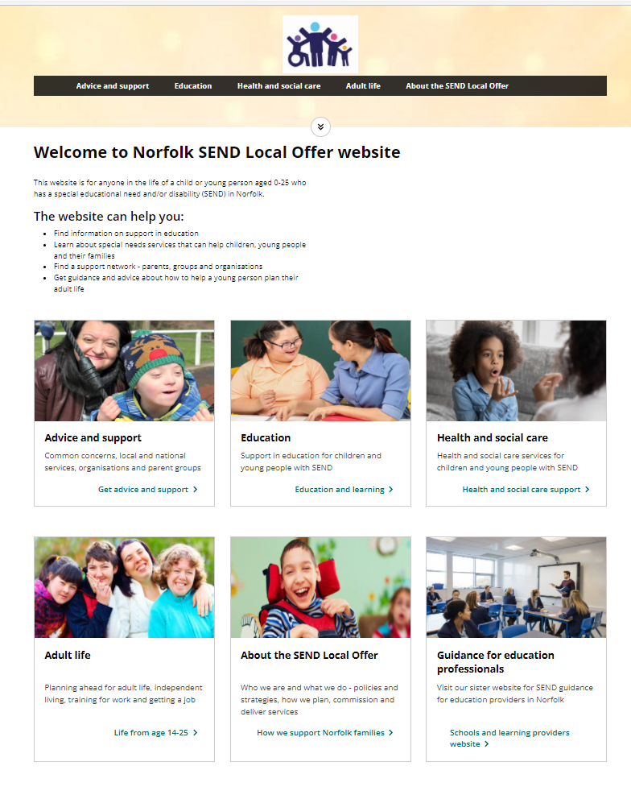
https://www.norfolk.gov.uk/children-and-families/send-local-offer

Slide 47
Contacts
If you wish to discuss our SEND provision further please contact us:-
SENCO - Liz Clark senco@sprowstonjunior.norfolk.sch.uk
Head - Matt Walton office@sprowstonjunior.norfolk.sch.uk
SEND Governor - Hayley Stockwell office@sprowstonjunior.norfolk.sch.uk
If you wish to make a complaint please see our
Complaints Policy

Slide 48
Sprowston Junior School
SEN Information Report for 2026-2027
Part of the Norfolk Local Offer for learners with Special Educational Needs (SEN-D)
October 2026- to be reviewed October 2027
Written after consultation with teachers, teaching assistants, parents and governors.
A brief version is available from the office or on our website.
Please contact us if you would like a paper or adapted copy

